Slide 1
I400 – Application Development in Java
Lecture 4

Slide 2
Today
CH 5 – Loops
while
break
do-while
for
Nested loops
Homework 1 is due next Tuesday (1/23) by 5pm
All homework descriptions are available in Canvas under Assignments
CH 4: 23
CH 5: 17, 21, 37, 49

Slide 3
Loops
Java includes while and for loops, just like Python.
Additionally, it includes one other type of loop, the do-while, which is used in similar circumstances as intentional infinite loops.
Let’s review each type of loop.

Slide 4
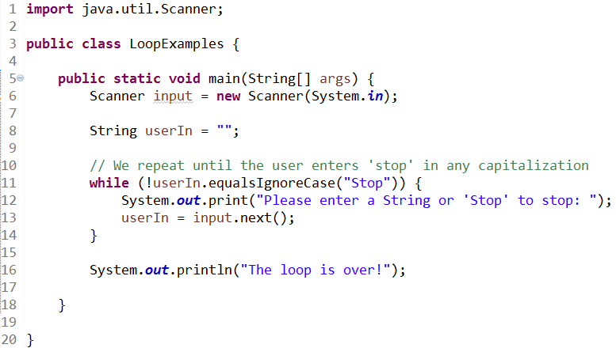
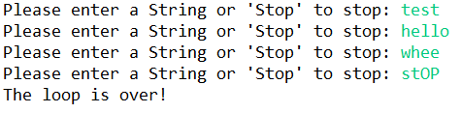
While Loops
While loops repeat until a Boolean condition is false.

Slide 5
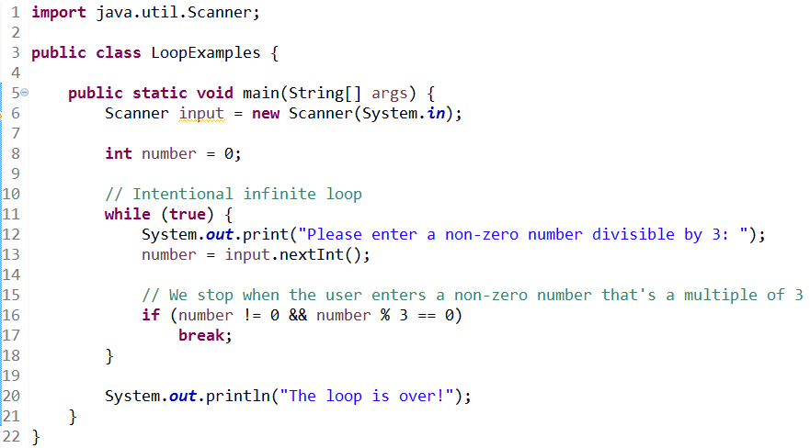

break
break in Java works exactly the same as in Python:

Slide 6
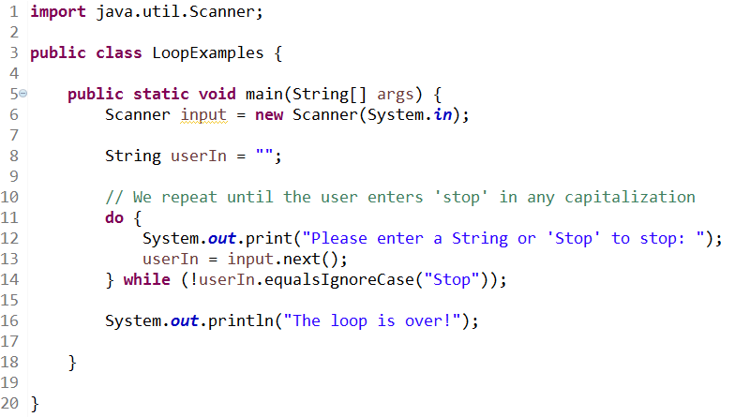
Do-While Loops
If we know that we’ll need to run the loop at least once, we can convert a while loop into a do-while loop. Be careful! do-while loops end in a ;

Slide 7
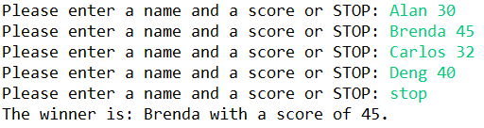
High Score (Group Work)
Write the HighScore class. The user is asked to enter a series of names and scores (each entry on the same line) until they enter STOP (in any case).
Once the user has entered all the scores, display the player with the high score.
HINT: We’ve shown you how to split up this input!

Slide 8
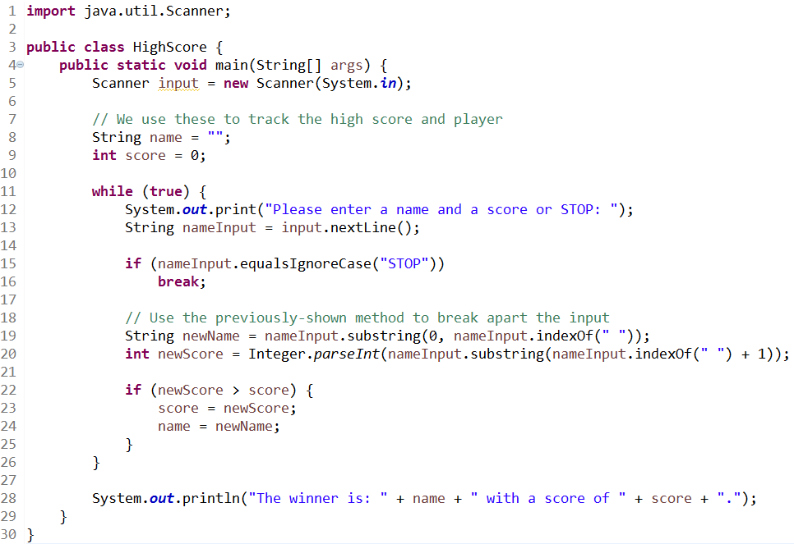
High Score (Solution)

Slide 9
For Loops
The syntax used by for loops in Java is noticeably different from Python.
for i in range(0,10,1):
# loop body
for (int i = 0; i < 10; i++) {
// loop body
}
Each language has a different way to declare the starting value, stop value, and increment.
Python:
Java:

Slide 10
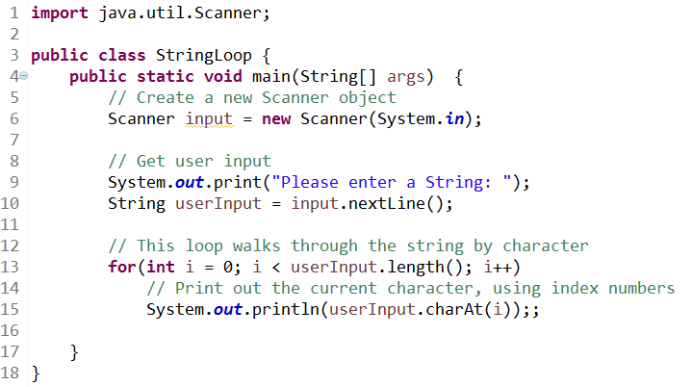
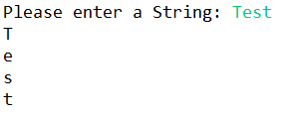
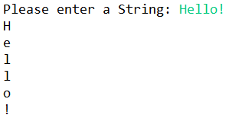
For Loops
Here we see how to loop over a String:
The combination of a for loop with .length() is used in the same situation where you would use range(len(sequence)) in Python.

Slide 11


Palindrome pt 1 (Group Work)
Write the Palindrome class. The user is asked to enter a string, then told whether or not it is a palindrome: “a word, phrase, or sequence that reads the same backward as forward”.
For this version of the program, exact equality is fine.
HINT: How can you match each character with its opposite?

Slide 12
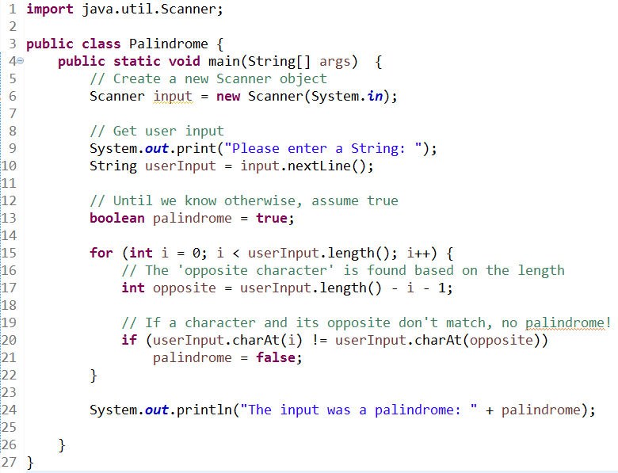
Palindrome pt 1 (Solution)

Slide 13

Palindrome pt 2 (Group Work)
Improve the Palindrome class.
Capitalization should be ignored when comparing ‘opposite’ characters, and spaces / punctuation characters should be ignored entirely.
HINT: Build a new string without ‘ignored’ characters. The Character methods will also be helpful!

Slide 14
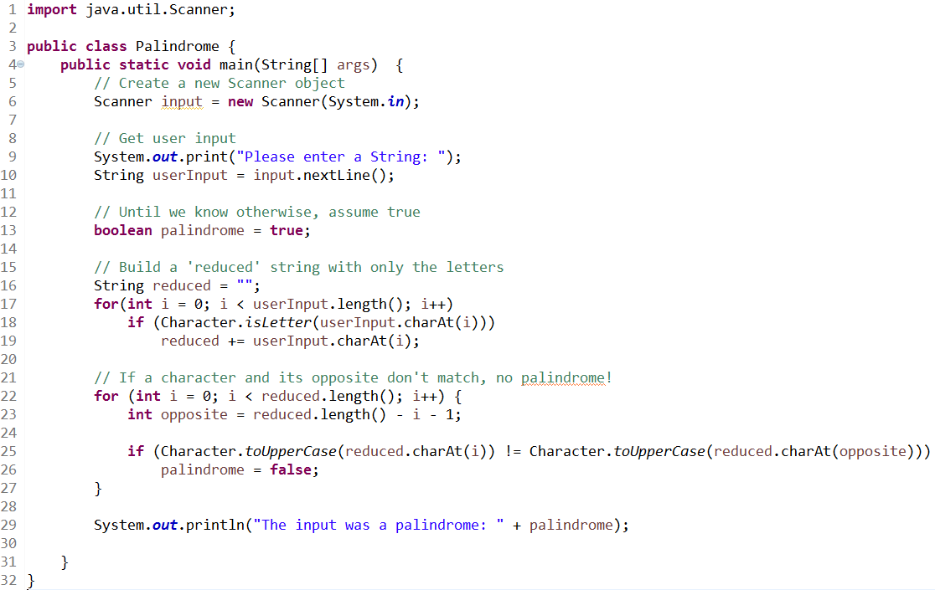
Palindrome pt 2 (Solution)

Slide 15
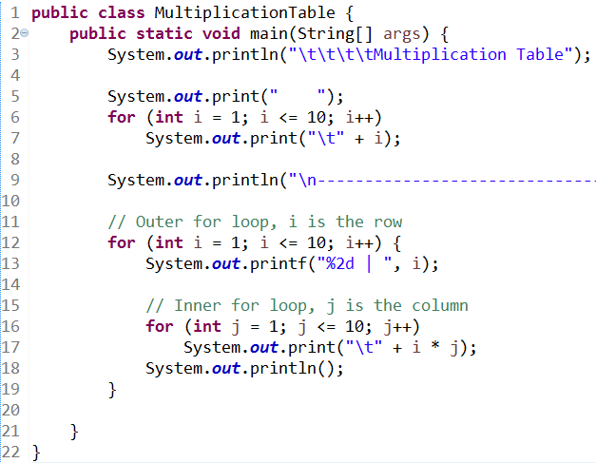
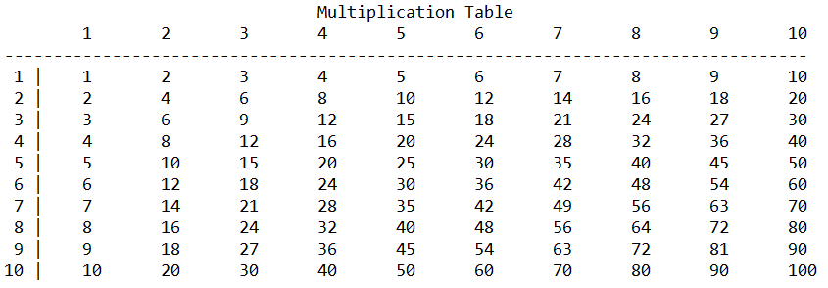
Nested Loops
Here is the multiplication table example from I210:

Slide 16
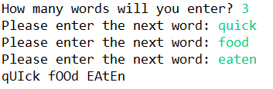
Loud Vowels (Group Work)
Write the LoudVowels class. The user specifies a number of words to enter, then we output the words put together into a phrase. All vowels in the words have been capitalized.
HINTS:
Use nested loops
Remember, if you want the character at index position j, use the .charAt(j) method.
To detect a vowel, convert each character to its uppercase equivalent with Character.toUpperCase(), then compare it to ‘A’, ‘E’, etc.

Slide 17
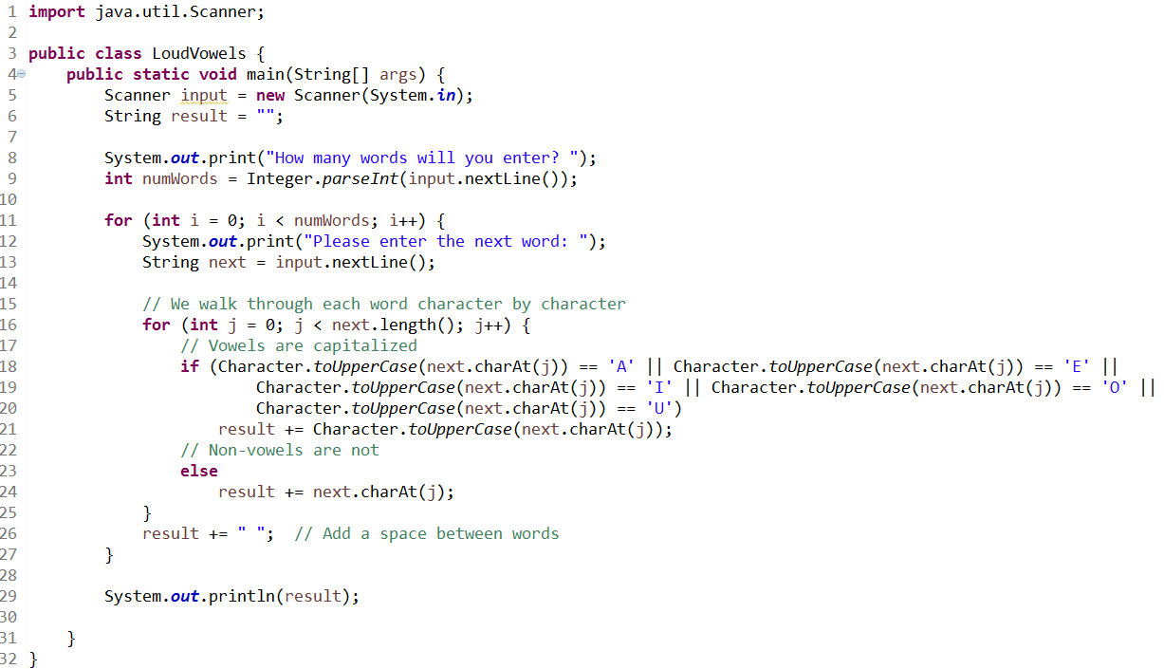
Loud Vowels (Solution)

Slide 18
Questions?

